Slide 1
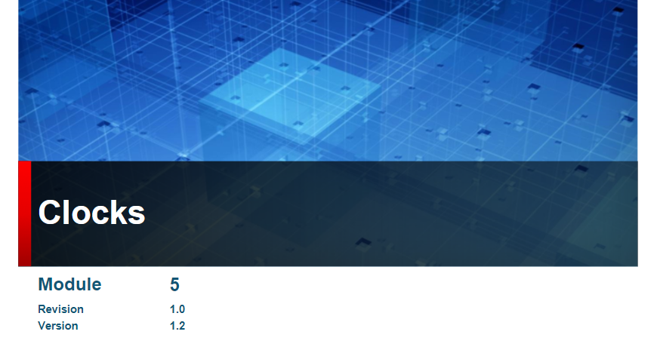

Slide 2
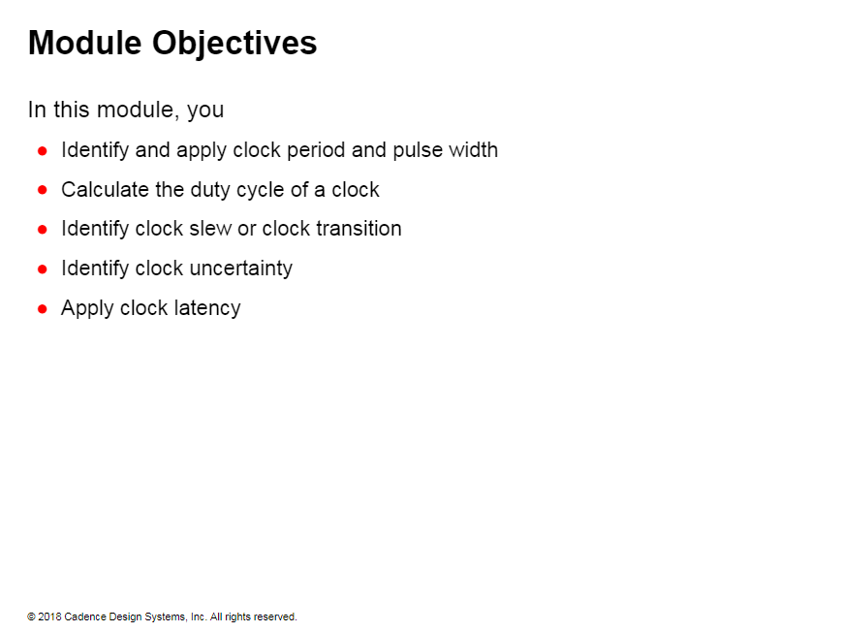

Slide 3
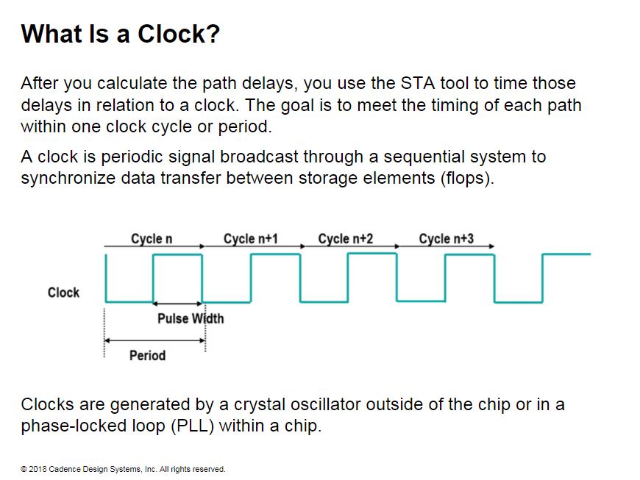
Notes:
What is a Clock?
Clocks are essential in a digital circuit because they drive the sequential cells that act as a memory device and are also used in state machines to control the design.
Each clock port of a sequential cell has a clock waveform. In this illustration, the rising edge triggers the clock port of the positive-edge flops, and the falling edge triggers the clock port of the negative­ edge flops.
Function of a clock
The clock signal drives one of the following storage elements:
• Positive edge­ triggered flop, written in the Verilog language as always@(posedge clock). This code creates flops triggered on the positive edge of a clock.
• Negative edge­ triggered flop, written in the Verilog language as always@(negedge clock). This code creates flops triggered on the negative edge of a clock."
• Level-sensitive triggered on high or low value of the clock signal, written in the Verilog language as always@(clock). This code creates latches."

Slide 4
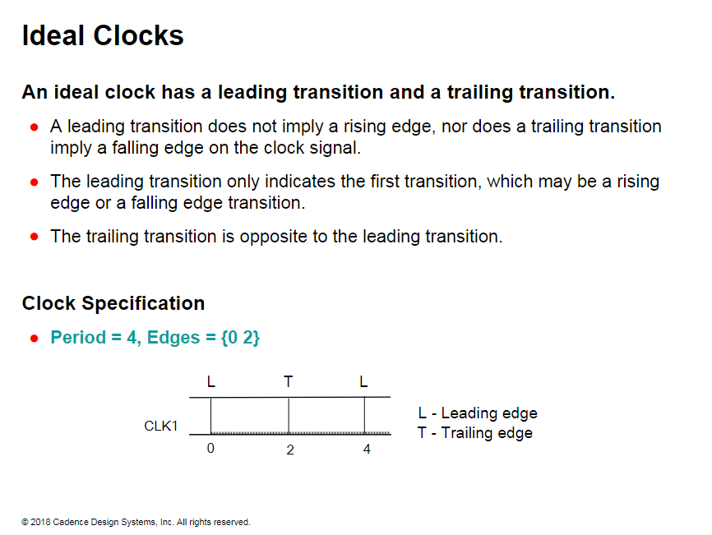

Slide 5
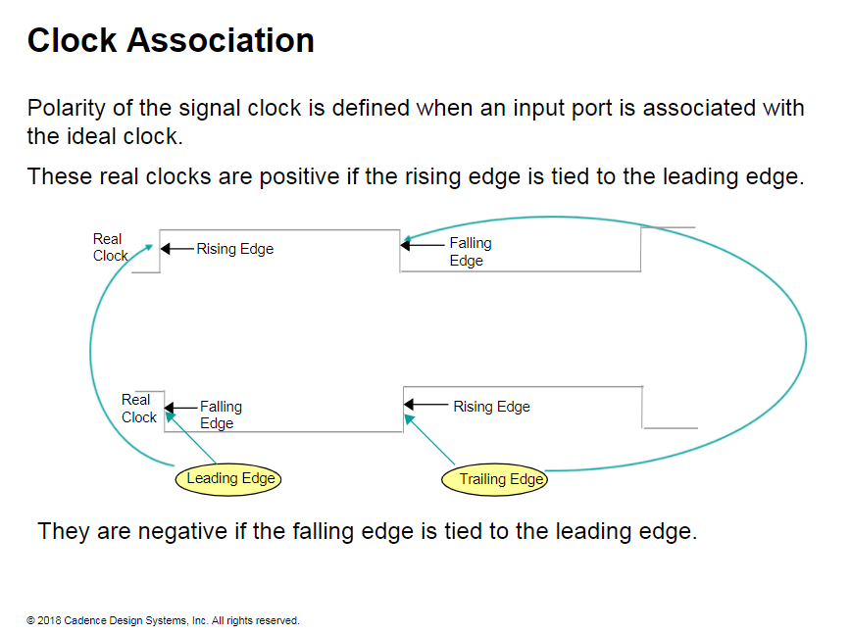
Notes:
“Positive clocks associate the rising edge of the clock with the leading edge of the ideal clock, and the falling edge of the clock with the trailing edge of the ideal clock."
"Negative clocks associate the falling edge of the clock with the leading edge of the ideal clock, and the rising edge with the trailing edge of the ideal clock."

Slide 6
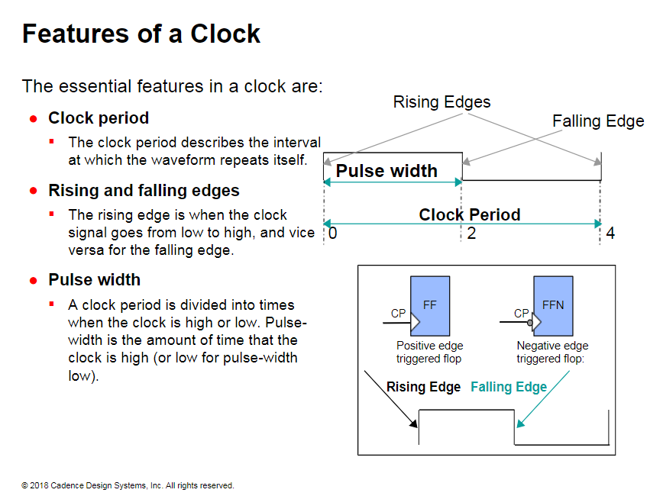
Notes:
Features of a Clock
Clocks have a rising edge and a falling edge to trigger Positive or negative edge flops

Slide 7
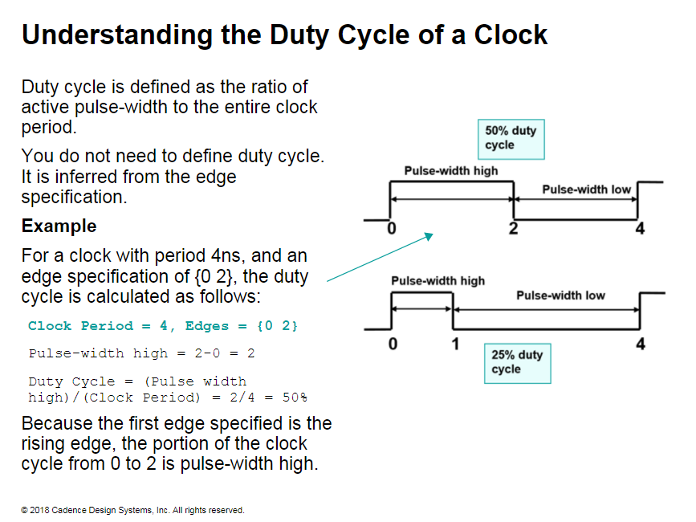
Notes:
When the clock spends an equal amount of time in high and low phases, it is known as a 50% duty cycle."
The duty-cycle of a clock is not of great importance in designs that are composed of edge-triggered flops with same-edge sensitivity. Designs with a mix of positive and negative edge-triggered flops are affected by duty cycle when a transfer of data occurs between flops of different edge sensitivity.
"Designs with level-sensitive devices such as latches are much more sensitive to the duty cycle, because the duty cycle determines when the latch is transparent or opaque."

Slide 8
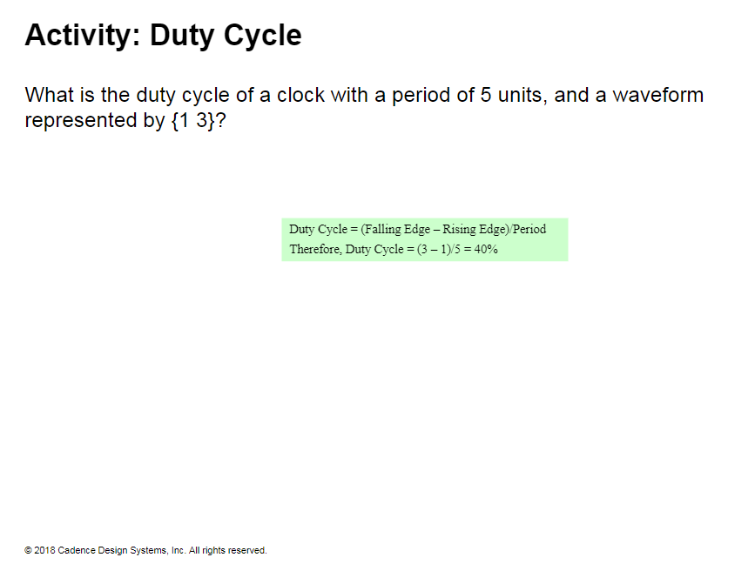

Slide 9
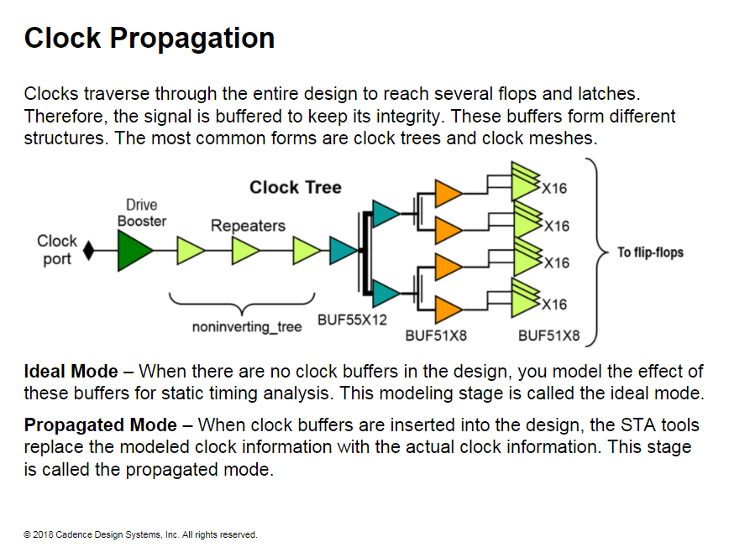

Slide 10
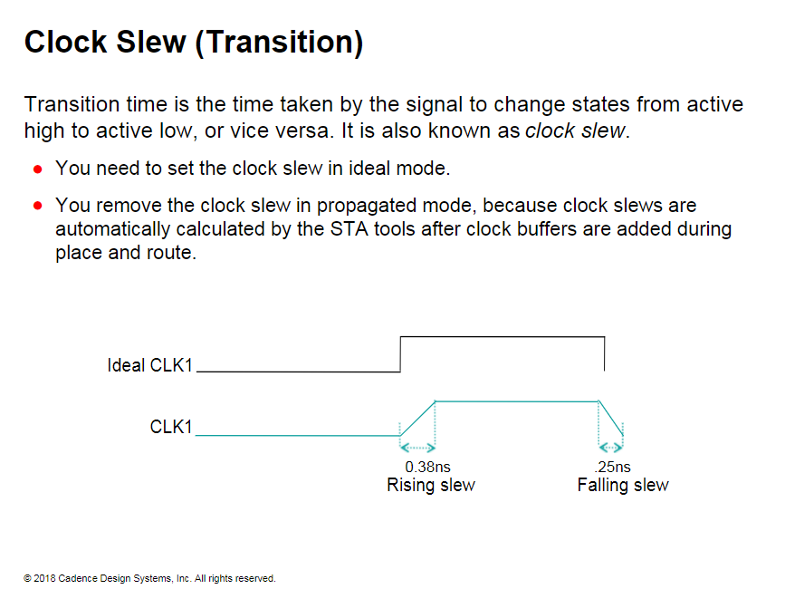
Notes:
The ideal clock takes no time to make the transition between high and low. Any signal takes some time to switch between the high and low states. This transition time is necessary to calculate the delays of the path accurately."

Slide 11
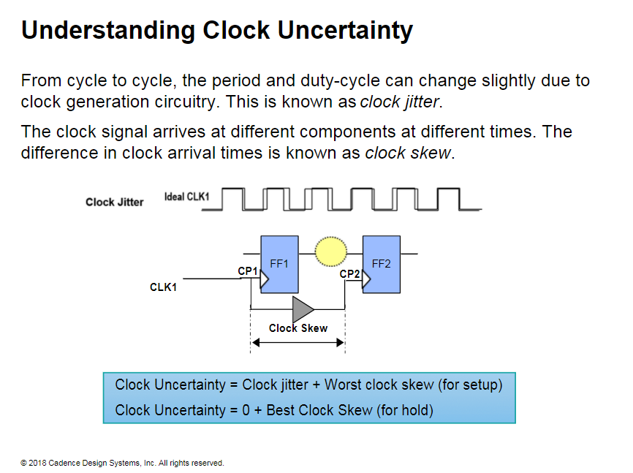
Notes:
In this illustration, the clock signal arrives at different flops at different times due to the clock buffers and the clock net delays.
The difference in delay of the clock buffers and nets to the different clock pins becomes skew. You use the skew and the clock jitter to model uncertainty.
Clock uncertainty can be viewed as a general method to add pessimism . Use uncertainty to tighten constraints on paths that start in one clock domain and end in another clock domain.

Slide 12
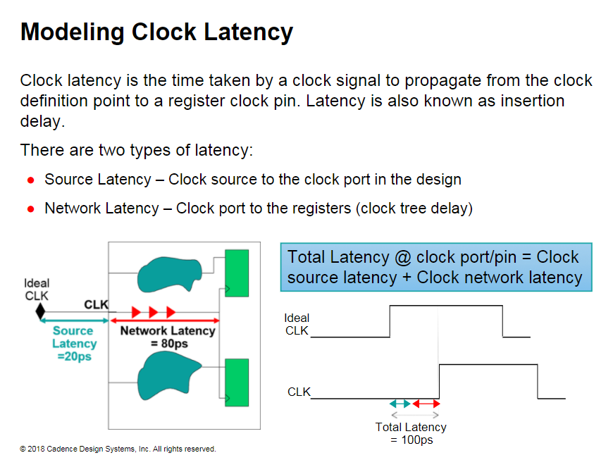
Notes:
The skew of a clock tree is the difference between the minimum and maximum insertion delays of the tree.
Clock Source Latency is the time a clock signal takes to propagate from its ideal waveform origin to the clock po1t in the design.
Clock Network Latency is the time a clock signal takes to propagate from the clock port to a register clock pin.
Network latency is also called clock tree delay.
The latency at a register clock pin is the sum of clock source latency and clock network latency.

Slide 13
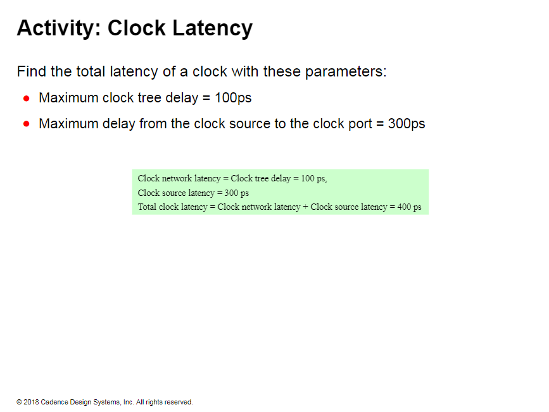

Slide 14
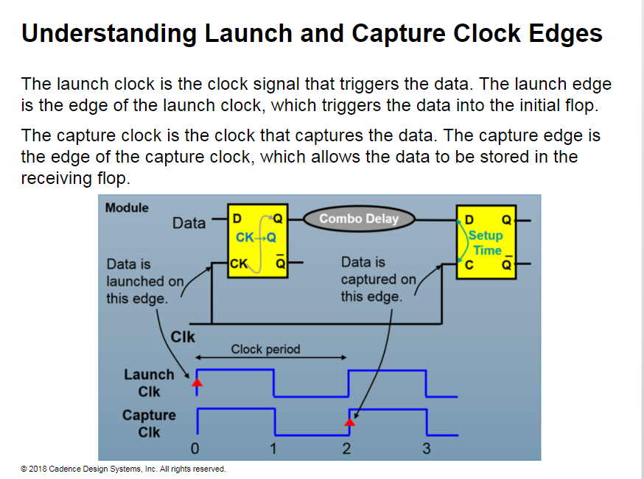
Notes:
In a single clock design, as in this illustration, the data has one clock period to travel from the launch edge to the capture edge.
The capture clock edge is where the timing checks are done.
To perform setup and hold checks, the STA tool must establish a frame of reference to calculate the clock and data arrival times.
Because the launch clock edge is where the data is triggered, it is considered to be time zero, and is the frame of reference for timing both data and clock.
As the data travels through to the next stage, the delays of the timing arcs are calculated relative to the launch clock edge.
The capture clock edge is also timed relative to the launch clock edge.
If the data arrives in time before the capture clock edge, then the data is stored in the flop.
The STA tools also check whether the data meets the setup and hold requirement at the capture clock edge to make sure that the data is properly captured.

Slide 15
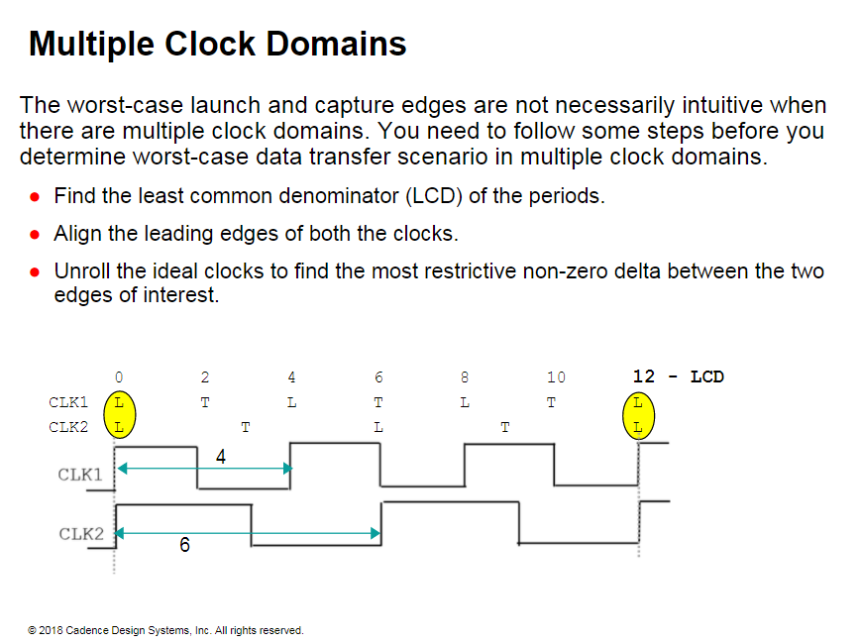
Notes:
"In the graphic, the clock CLK 1 has a period of 4ns, and clock CLK2 has a period of 6ns.The least common denominator (LCD) is 12. When you align the leading edges of the clocks, in this case, both are shown to be rising edges, you can determine the several transactions between the two clocks."

Slide 16
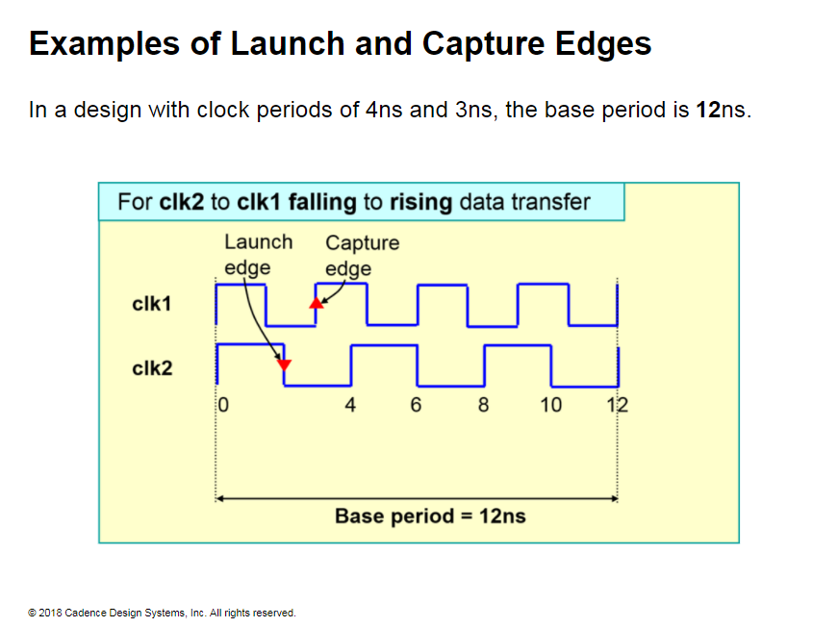
Notes:
In this example, the leading edges are assumed to be the launch and capture edges. Therefore, the first cycle launch to capture shift is always zero

Slide 17
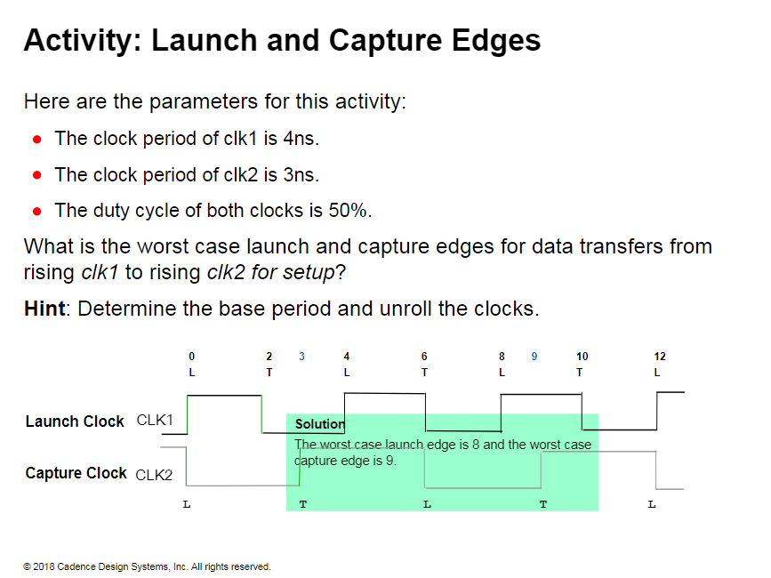

Slide 18
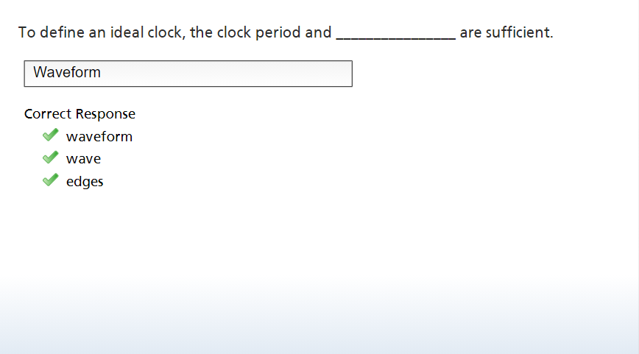

Slide 19
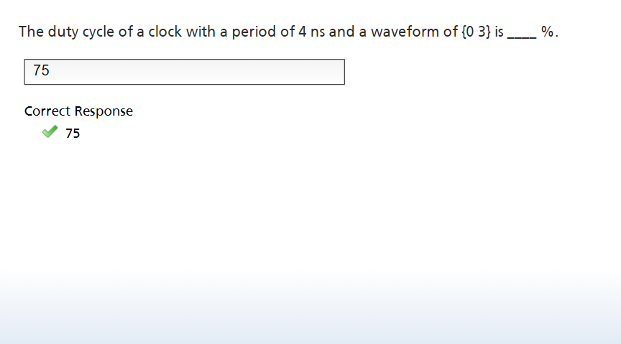

Slide 20
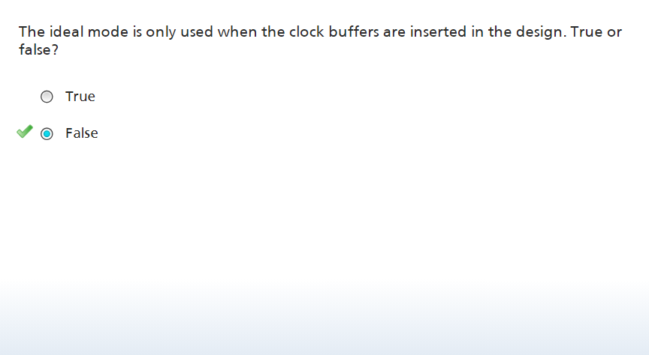

Slide 21
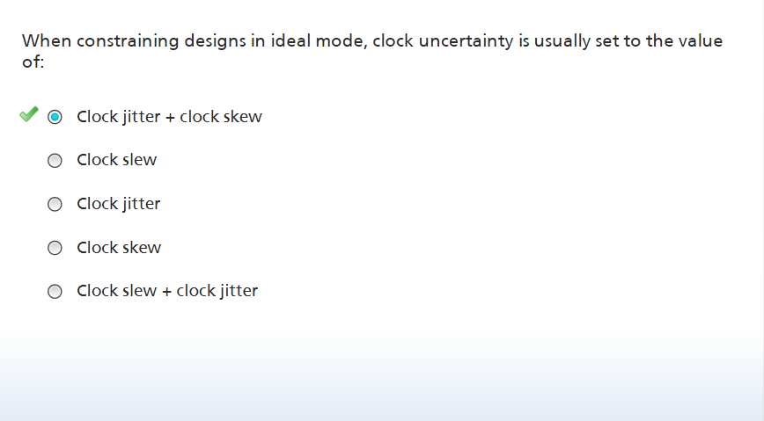

Slide 22
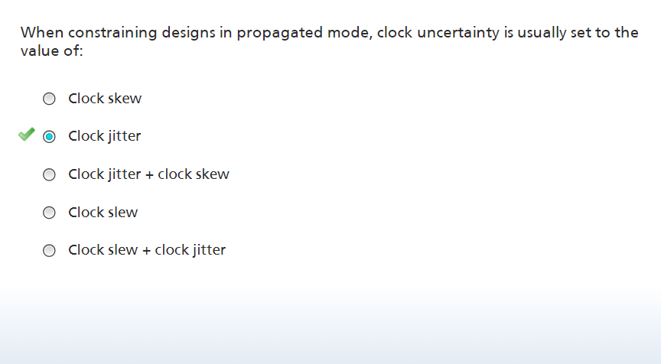

Slide 23
